Slide 1
Ways to Reduce Your Bounce Rate !
By

Slide 2
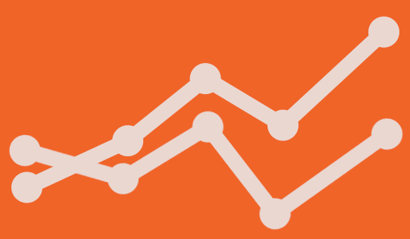
What’s bounce rate?
Bounce rate is a metric that measures the percentage of people who land on your website, and do completely nothing on the page they entered. So they don’t click on a menu item, a ‘read more’ link, or any other internal links on the page. This means that the Google Analytics server doesn’t receive a trigger from the visitor.
"Bounce rate is the percentage of single page visit(or web sessions) in which a person leaves your website from the landing page without browsing any further."

Slide 3
How does Google Analytics calculate bounce rate?
Bounce rate is single-page sessions divided by all sessions, or the percentage of all sessions on your site in which users viewed only a single page and triggered only a single request to the Analytics server.
In other words, it collects all sessions where a visitor only visited one page and divides it by all sessions.
Bounce rate of web page : Total number of bounces on a page (in a given time period)/ total number of entrances on the page (in the same time period)
Bounce rate of a website : Total number of bounce across all the pages on the website (in a given time period)/ Total number of entrances across all the pages on the website (in the same time period).

Slide 4
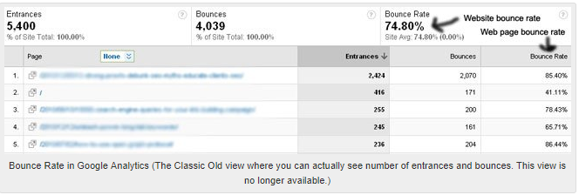
The bounce rate of the page 1 is calculated as : [total bounces(20170)/total entrances(2424)]*100= 85.40%
The bounce rate of the home page (/) is calculated as: [total bounces (171)/total entrances(416)]*100 = 41.11%
The bounce rate of the website is calculated as: [total bounces(4039)/total entrances(5400)]*100=74.80%

Slide 5
Having a high bounce rate can mean three things !
A high bounce rate generally indicate that site entrance page aren't relevant to your visitors.
1. The quality of the page is low. There’s nothing inviting to engage with.
2. Your audience doesn’t match the purpose of the page, as they won’t engage with your page.
3. Visitors have found the information that they were looking for.

Slide 6

Ways to Reduce Your Bounce Rate
Optimize Page Load Time
A web page can have, taking forever to load is arguably the worst. After all, it doesn’t matter how good or bad a page’s content is if a user can’t read it (or even see it), and 47% of users expect a web page to load in two seconds or less, making on-page optimization crucial to reducing your bounce rate.

Slide 7
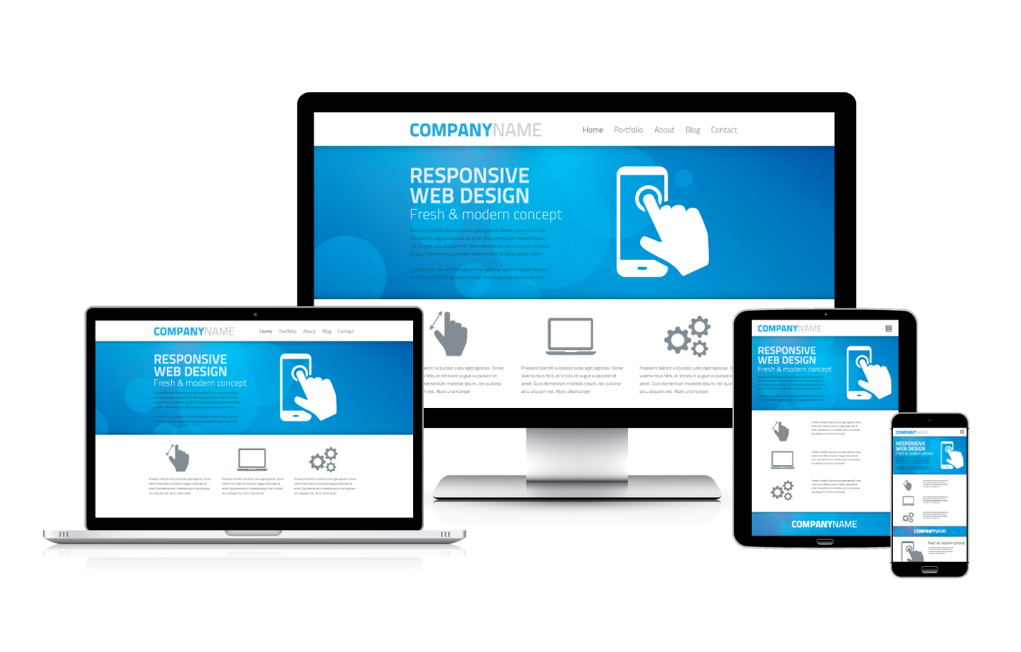
Optimize for Mobile
According to official Google statements, more than 50 percent of search queries globally now come from mobile devices. So It will help to reduce bounce rate.

Slide 8
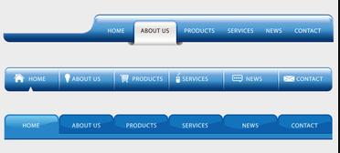
Make Your Site’s Navigation Effortless
Your site navigation should be clear, immediately understood, and offer the user a seamless experience in getting from one part of your site to another. Visitors shouldn’t have to guess where they are in your site to know how to get around, and they shouldn’t be forced into artificial pathways that you’ve put in place to shepherd them through your sales funnel. Remember – they’re in control, not you.
Strong site navigation makes it easy for visitors to quickly find the information that interests them, sans a potentially frustrating “hunt.” It also helps search engines index your important information efficiently and effectively.

Slide 9
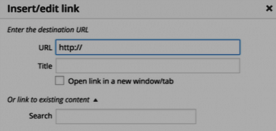
Add links to more pages within your website in your content
Think about other pages that people interested in that piece of content will want to see, and link to them throughout the content and at the end in a “if you liked this, you’ll love this” kind of way.
Interlink Your Posts
Besides adding related links at the end of a post, another similar linking strategy you can use to drive up page views is to link to other posts or pages directly within the text of your content.

Slide 10
Make Your Content More Accessible with Smart Formatting
Formatting your pages to be as welcoming and accessible as possible is one of the best ways to reduce your bounce rate. The less “work” a visitor has to do to get what they want, the more likely they are to stick around. Don’t overwhelm your visitors with weighty paragraphs that span entire pages, and make use of white space to make your content more approachable.
Here are some ways to make content less visually intimidating:
Appropriate use of headers
Frequent subheadings
Suitable images
Bulleted lists (see what I did there?)

Slide 11
Target Keywords With High-Value Traffic
Keywords can make or break your content marketing campaign. If you want to improve search performance, start targeting high-value keywords, because that’s where the high-value traffic is.
A perfect high-value keyword sits at the intersection of four important metrics:
Traffic value
Conversion value
Persona value
Brand value

Slide 12
Provide Quality Content
Content is King.
Have an obvious main message.
Use clear headers and subheads.
Tailor content to intended visitors.
Use stylish copy and images.
Make your content error-free.
Include a clear call-to-action and obvious links to next steps.

Slide 13
Create Multiple Landing Pages for High-Volume Keywords
Creating more landing pages also increases your search click-through rate. In that respect, it’s a numbers game.
Once you have more landing pages, first make sure that they’re easy to navigate, then link to all of them from your homepage. You might even link to the separate landing pages on your navigation menu. You might have higher bounce if people don’t quickly find what they hoped for. Multiple landing pages help here.
Some companies who have increased their number of landing pages from 10 to 15 have seen a 55% increase in leads.

Slide 14
Conclusion
Bounce rate is a metric you can use to analyze your marketing efforts. You can use it to measure if you’re living up to your visitors’ expectations. Nevertheless, you want them to engage with your site. So you can use the bounce rate to decide which pages need more attention. Meeting your visitors’ expectations and making your pages more inviting for visitors all leads to creating an awesome website. And we all know that awesome websites rank better!

Slide 15
Thanks…

